Slide 1
Civic Access
Intelligent Public Grievance and
Statutory Escalation Platform
Complaint guidance, legal context and filing preparation
for citizens in Pakistan
Pak Angels • Pakistan National Impact Challenge
Civic Access • 4 October 2026
01
Notes:
Project presentation for the Pak Angels Pakistan National Impact Challenge.
Source: Project PRD v1.1; implementation baseline 598ca69. Capability counts describe the demonstration, not independently verified legal outcomes.

Slide 2
The citizen’s problem
01
Choosing the correct provider or authority is difficult.
02
Rules, evidence requirements and complaint channels are scattered.
03
An inaccurate recipient or premature escalation can delay action.
04
Citizens need a clear filing process and a record they can use.
Civic Access • 4 October 2026
02
Notes:
Source: Project PRD v1.1; implementation baseline 598ca69. Capability counts describe the demonstration, not independently verified legal outcomes.

Slide 3
What the product helps people do
01
Describe the issue in English, Urdu or Roman Urdu.
02
Confirm the department and understand its powers and limits.
03
Prepare the facts, relevant references and optional evidence.
04
Use the official channel and retain the acknowledgment.
Civic Access • 4 October 2026
03
Notes:
Source: Project PRD v1.1; implementation baseline 598ca69. Capability counts describe the demonstration, not independently verified legal outcomes.

Slide 4
The complaint journey
Stage | Citizen experience
Understand | Describe the issue and confirm provider, territory and complaint stage.
Prepare | Review legal context, readiness checklist and a downloadable petition.
File | Open the official portal or follow offline filing instructions.
Follow up | Record an acknowledgment and download a personal calendar reminder.
The citizen reviews and submits. The current app does not send complaints.
Civic Access • 4 October 2026
04
Notes:
Source: Project PRD v1.1; implementation baseline 598ca69. Capability counts describe the demonstration, not independently verified legal outcomes.

Slide 5
Six specialist workflow modules
Agent | Responsibility
01 Intake and OCR | Preserve the complaint and suggest details from optional documents.
02 Jurisdiction RAG | Retrieve scoped legal sources and identify the appropriate route.
03 Audit Readiness | Explain the evidence checklist and preparation score.
04 Petition Builder | Create a formal draft with source-linked applicable provisions.
05 Dispatch and Router | Provide official channels and offline instructions.
06 Tracker and Analytics | Provide reminders, filing records and consented aggregates.
Current implementation: six Python workflow stages, not six autonomous LLMs.
Civic Access • 4 October 2026
05
Notes:
Source: Project PRD v1.1; implementation baseline 598ca69. Capability counts describe the demonstration, not independently verified legal outcomes.

Slide 6
Service coverage
Sector | Coverage
Electricity | 11 public DISCOs, K-Electric and NEPRA
Telecom | Jazz, Zong, Ufone, Telenor, Onic, PTCL, SCOM/SCO and PTA
Banking | Banking Mohtasib Pakistan and State Bank; institution-first Sunwai guidance
Other institutions | PEMRA, gas utilities, OGRA, federal and provincial service bodies
83 directory entries • 83 guidance profiles • 278 source summaries
Research depth varies; these counts do not mean every legal filing route is fully verified.
Civic Access • 4 October 2026
06
Notes:
Source: Project PRD v1.1; implementation baseline 598ca69. Capability counts describe the demonstration, not independently verified legal outcomes.

Slide 7
The provider comes first
Issue | First step | Possible next forum
Telecom service | Complain to the actual operator | PTA, subject to eligibility and earlier records
Electricity bill | Complain to the supplier on the bill | NEPRA, where the procedure applies
Banking service | Complain to the financial institution | BMP or SBP according to jurisdiction
SBP is not a general appeal from Banking Mohtasib decisions.
Territorial, court and formal-appeal exceptions require review.
Civic Access • 4 October 2026
07
Notes:
Source: Project PRD v1.1; implementation baseline 598ca69. Capability counts describe the demonstration, not independently verified legal outcomes.

Slide 8
Legal guidance people can inspect
01
Explain the governing framework, rights and available remedies.
02
Attach official sources and distinguish procedure from alleged breach.
03
Use a verified receiving role where available; disclose missing details.
04
Flag conflicting rules, uncertain jurisdiction and outdated material.
Civic Access • 4 October 2026
08
Notes:
Source: Project PRD v1.1; implementation baseline 598ca69. Capability counts describe the demonstration, not independently verified legal outcomes.

Slide 9
FIR and Right to Information
FIR and Offence Guide
Right to Information
13 common incident scenarios
Fact questions and potential PPC or PECA provisions
CrPC reporting procedure and evidence preparation
Federal and provincial guidance
Identify the record holder and request specific records
Download a request and understand review options
The app does not determine guilt, guarantee FIR registration or assume an unverified territorial law.
Civic Access • 4 October 2026
09
Notes:
Source: Project PRD v1.1; implementation baseline 598ca69. Capability counts describe the demonstration, not independently verified legal outcomes.

Slide 10
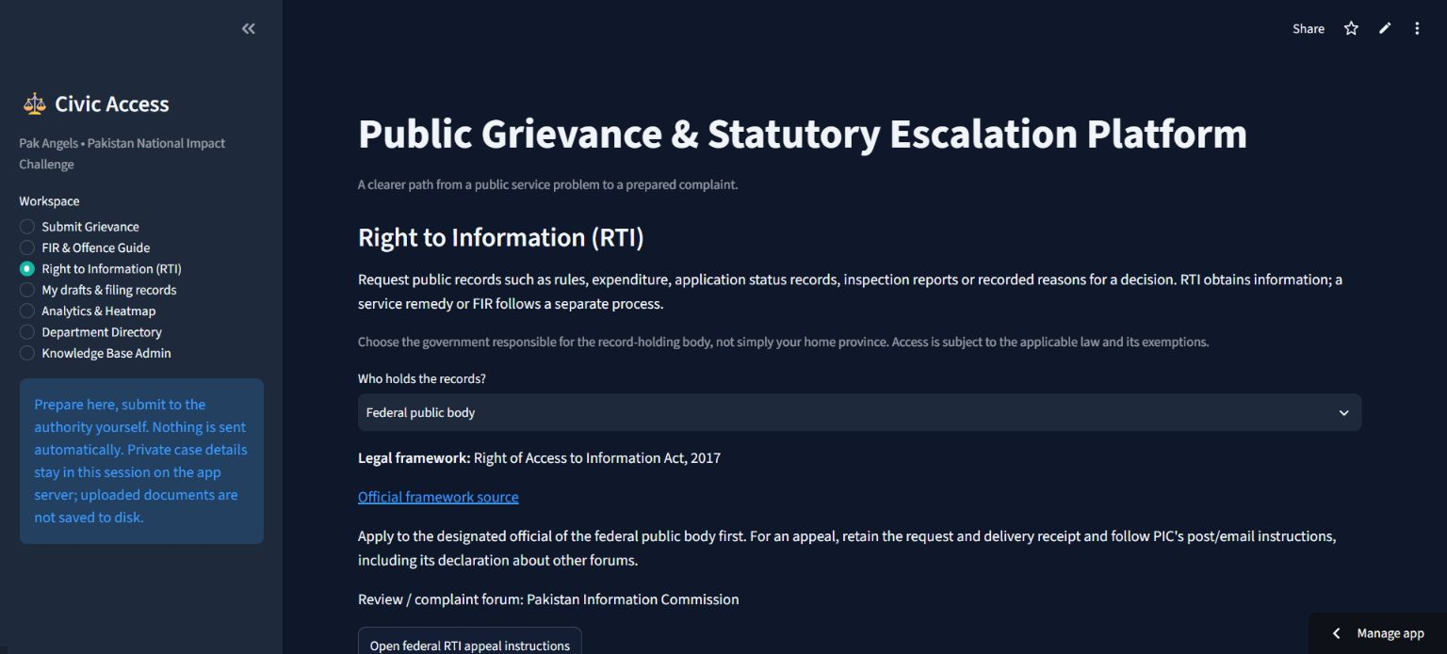
The deployed RTI workspace
Civic Access • 4 October 2026
10
Notes:
Screenshot of the deployed project captured during the verified update on 4 October 2026.
Source: Project PRD v1.1; implementation baseline 598ca69. Capability counts describe the demonstration, not independently verified legal outcomes.

Slide 11
Privacy and user control
01
Guidance and official links are accessible without identity details.
02
Petition identity fields: CNIC number, expiry date and mobile number.
03
All uploads are optional; users review OCR and generated text.
04
Private cases are session-local; analytics requires separate consent.
Civic Access • 4 October 2026
11
Notes:
Source: Project PRD v1.1; implementation baseline 598ca69. Capability counts describe the demonstration, not independently verified legal outcomes.

Slide 12
Current release and next stages
Stage | Status and next outcome
Working demonstration | Text intake, guidance, petitions, FIR and RTI journeys; 151 tests passed.
Knowledge completion | Verify remaining recipients, issue-specific provisions and portal fields.
Public pilot hardening | Add administrator authorization, privacy controls and usability evaluation.
Later integrations | Consider authorized autofill, dispatch and authentic status reconciliation.
Audio remains disabled after unreliable Urdu transcription. Dates and budget need approval.
Civic Access • 4 October 2026
12
Notes:
Source: Project PRD v1.1; implementation baseline 598ca69. Capability counts describe the demonstration, not independently verified legal outcomes.

Slide 13
Project team
Role | Name | Email | Cell phone
Team Leader | Sajjad Ahmad | sajjad.danish@gmail.com | 03005996696
Team Member #01 | Anam Arif | anamarif28@gmail.com | 03005025666
Team Member #02 | Junaid Nagi | junaidnagi@gmail.com | 03005525526
Team Member #03 | Maleeha Saeed | maleehasaeed79@gmail.com | 03005359436
Live demonstration
https://public-grievance-platform.streamlit.app/
Civic Access • 4 October 2026
13
Notes:
Team names, roles, email addresses and phone numbers supplied by the project owner for inclusion in this presentation and GitHub documentation.
Source: Project PRD v1.1; implementation baseline 598ca69. Capability counts describe the demonstration, not independently verified legal outcomes.

